Slide 1



Marching to the Beat
of Our Brand
Audios Co. Record Studio
Corporate Branding Guidelines
01/15
Next

Slide 2

Eskwelabs x Autoserved
The Problem
01
Methodology & Data Science Tools
02
Key Topics
Exploratory Data Analysis
03
Modeling Results
04
Conclusions & Recommendation
05
Table of Contents
Back
Next

Slide 3


The Problem
Back
01/05
Next

Slide 4













Eskwelabs x Autoserved
DATA SCIENCE TOOLS
Integrated Development Environment & Software
Data Science Libraries
Deployment Apps
Tools that are primarily used to code and manipulate data.
Libraries that are used to perform data analysis and machine learning modeling
Applications that will be used for deployment and integration of our model.
Back
02/05
Next

Slide 5





Eskwelabs x Autoserved
Machine Learning Pipeline
Feature Engineering
Data Preprocessing
Data Cleaning
Modelling
Back
03/05
Next

Slide 6
Eskwelabs x Autoserved
Mileage
The total distance that the vehicle has traveled since it was purchased.
Important Features
Car Make
The name of a car’s manufacturer.
Car Model
Refers to the name of a car product and sometimes a range of products.
Car Year
Method of describing the version of vehicle.
Service Category
General categorization of services offered in the car repair shops.
Back
04/15
Next

Slide 7
An increase of service transactions have been observed due to new customers with recently expired manufacturer warranty.
Majority of the transactions (60%) are around the 30k to 80k mileage category.
Back
04/05
Next

Slide 8
Eskwelabs x Autoserved
Toyota topped the list of car manufacturers with the most service transactions.
Reflective of Toyota’s almost 39% market share of total automotive sales in the Philippines and their parts availability in the market.
Source: Statista.com
Back
05/15
Next

Slide 9
Eskwelabs x Autoserved
The brands of Ford and Chevrolet topped the charts with the highest maintenance and repair cost per car make.
Back
06/15
Next

Slide 10
Eskwelabs x Autoserved
On average, 3 out of every 5 car owners go visit the car service centers for an Oil, Lube, & Preventive Maintenance Service.
Back
08/15
Next

Slide 11
Eskwelabs x Autoserved
Back
06/15
Next

Slide 12
Most experts recommend replacing suspension parts after 80,000 km to 150,000 km.
Source: When to inspect your steering and suspension system | MOOG (moogparts.eu)
Back
04/05
Next

Slide 13
Back
04/05
Next

Slide 14
Most experts recommend replacing suspension parts after 80,000 km to 150,000 km.
Source: When to inspect your steering and suspension system | MOOG (moogparts.eu)
Back
04/05
Next

Slide 15
Eskwelabs x Autoserved
These are the service categories with
Back
06/15
Next

Slide 16
Eskwelabs x Autoserved
Back
06/15
Next

Slide 17
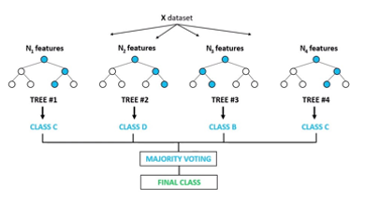


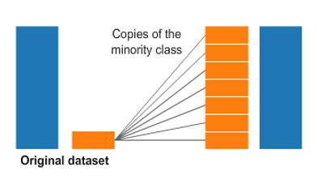
Random Forest Classifier
Eskwelabs x Autoserved
Model
Balanced Bagging Classifier
Oversampling
Back
03/05
Next

Slide 18
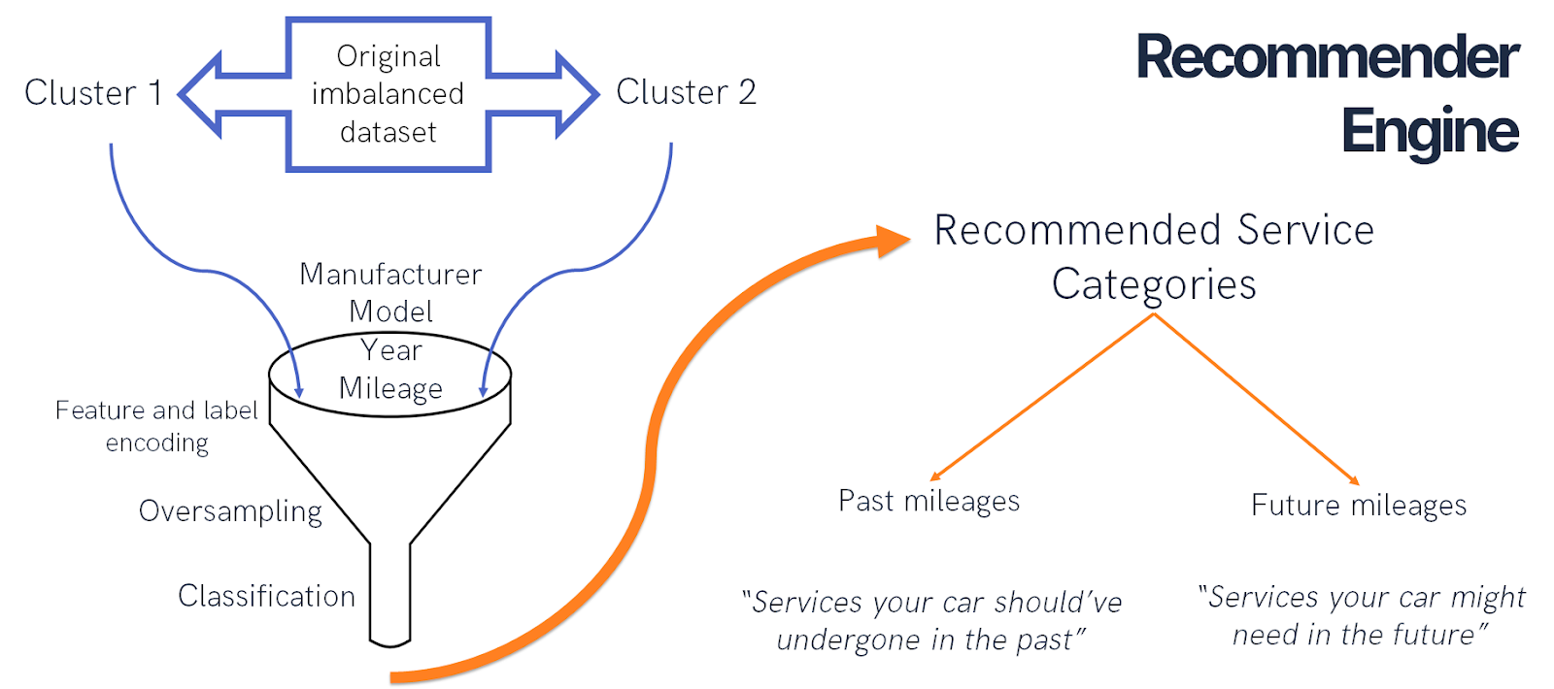
Back
03/05
Next

Slide 19
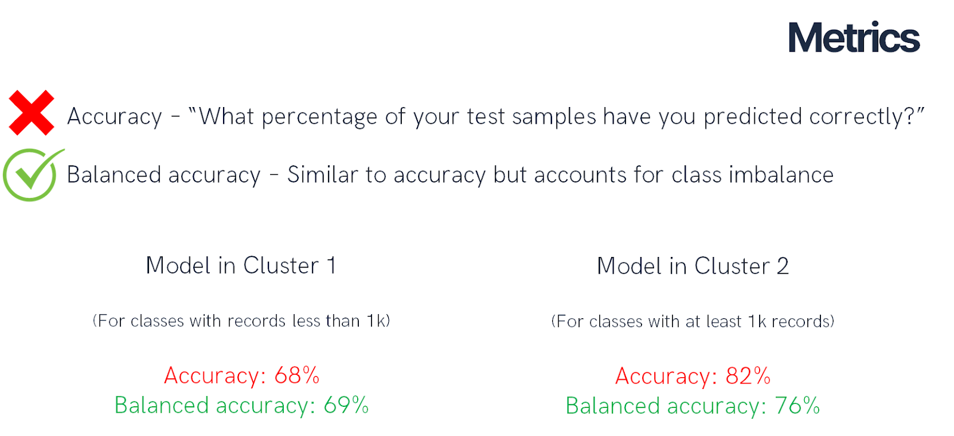
Back
03/05
Next

Slide 20
Eskwelabs x Autoserved
Majority of the cars being serviced are within the 30k to 80k mileage.
Hypothesis: There is an increase of customers since car owners have expired warranty when reaching this mileage.
Back
07/15
Next

Slide 21
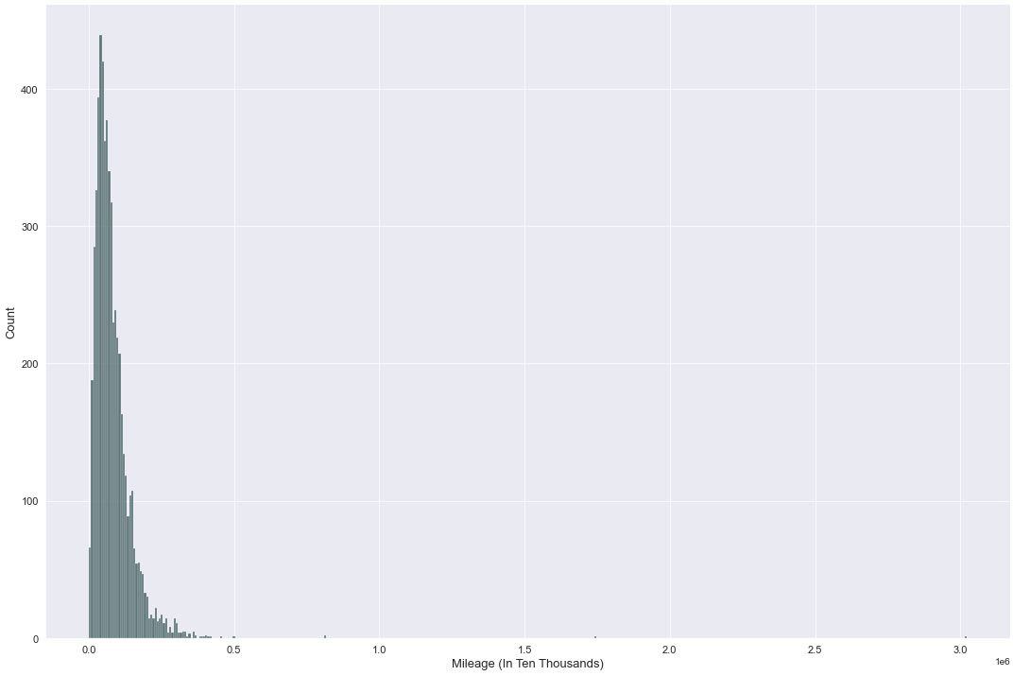
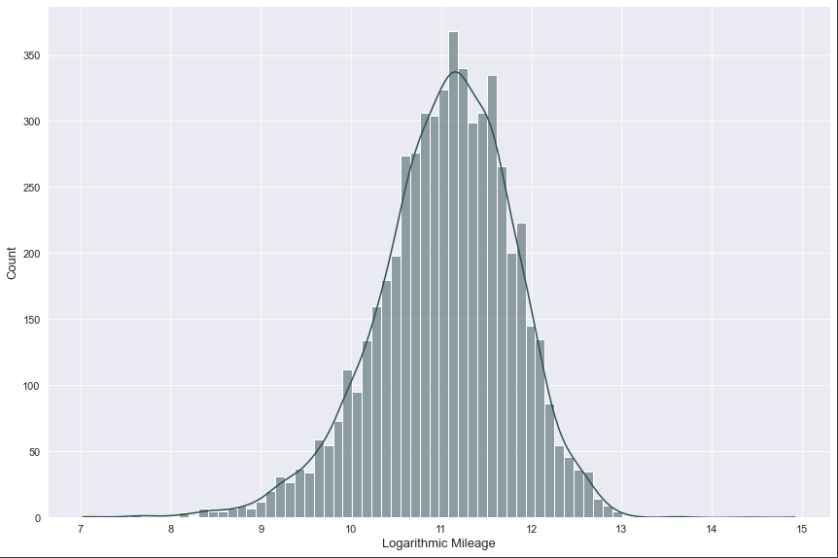
Mileage Analysis
Before Logarithmic Transformation
After Logarithmic Transformation
Skewness: 13.957
Kurtosis: 476.541
Normality Test | Statistic | P-Value | Conclusion
Shapiro Wilk Test | 0.9826858 | 8.7544357e -26 | Does not follow normal distribution
Lilliefors Test
Kolmogorov Smirnov Test
Back
04/05
Next

Slide 22
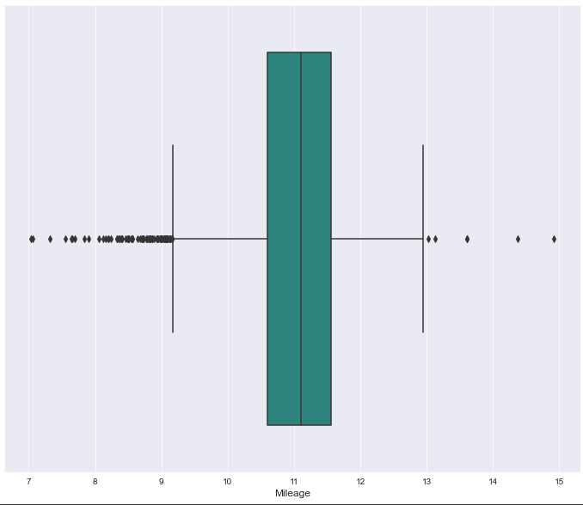
Mileage Analysis
Back
04/05
Next

Slide 23
Back
04/05
Next

Slide 24
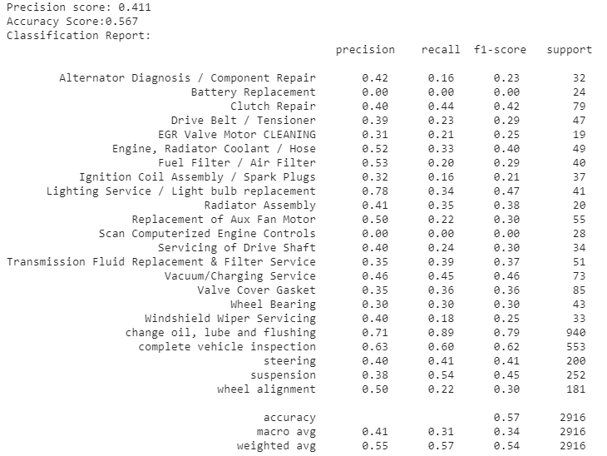
Modeling Results
We got an accuracy of around 57% using the default parameters of Random Forests & AdaBoost Classifier.
1.) Improve clustering of labels.
2.) We will conduct hyperparameter-tuning.
Back
04/05
Next

Slide 25




The Autoserved Team
Andre Gabriel Labayan
Melchor King Calma
Justine Paul Padayao
Patrick Nichol Nuguid
Data Scientist
Data Scientist
Data Scientist
Data Scientist
Back
05/05
Next

Slide 26




The Audios Co.
The Audios Co.
The Audios Co.
The Audios Co.
Primary Palette
Secondary Palette
Colors in Use
#d5d8db
#1d2b42
#d5d8db
Presentations are communication tools that can be used as demonstrations, lectures, speeches, reports, and more.
Presentations are communication tools that can be used as demonstrations, lectures, speeches, reports, and more.
Presentations are communication tools that can be used as demonstrations, lectures, speeches, reports, and more.
Back
15/26
Next

Slide 27
Eskwelabs x Autoserved
Car owners typically have their cars serviced beginning on Friday and peaking on Saturday.
In addition, fewer people have their cars serviced on Sunday.
Note: Subject for review because the value stated is just the total count per day for a period of 4 years (2018 – 2021).
Back
09/15
Next

Slide 28
Eskwelabs x Autoserved
The majority of car owners preferred to have their vehicle serviced between the hours of 8 and 9 a.m.
After peak hours, the number of car owners visiting auto repair shops gradually decreases.
Note: Subject for review because the value stated is just the total count per hour for a period of 4 years (2018 – 2021).
Back
10/15
Next

Slide 29
Eskwelabs x Autoserved
The highest number of vehicles being serviced is around the month of January.
Note: Subject for review because the value stated is just the total count per month for a period of 4 years (2018 – 2021).
Back
11/15
Next

Slide 30
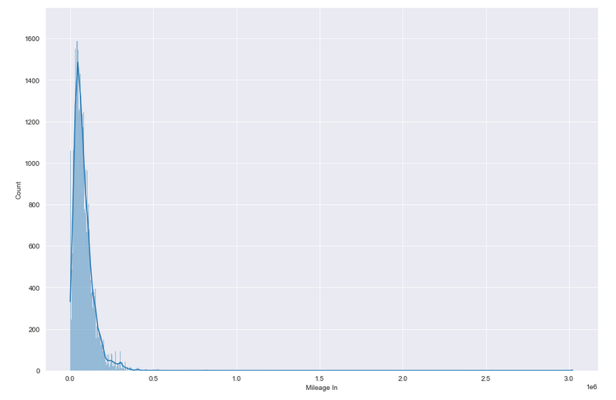
Eskwelabs x Autoserved
Work in progress: Conducting normality tests on the mileage distribution.
Current Roadblock: What are the important points when checking the normality of a distribution?
Back
12/15
Next

Slide 31

The Audios Co.
MUSIC IS THE SHORTHAND OF EMOTION.
Leo Tolstoy
Back
04/26
Next

Slide 32
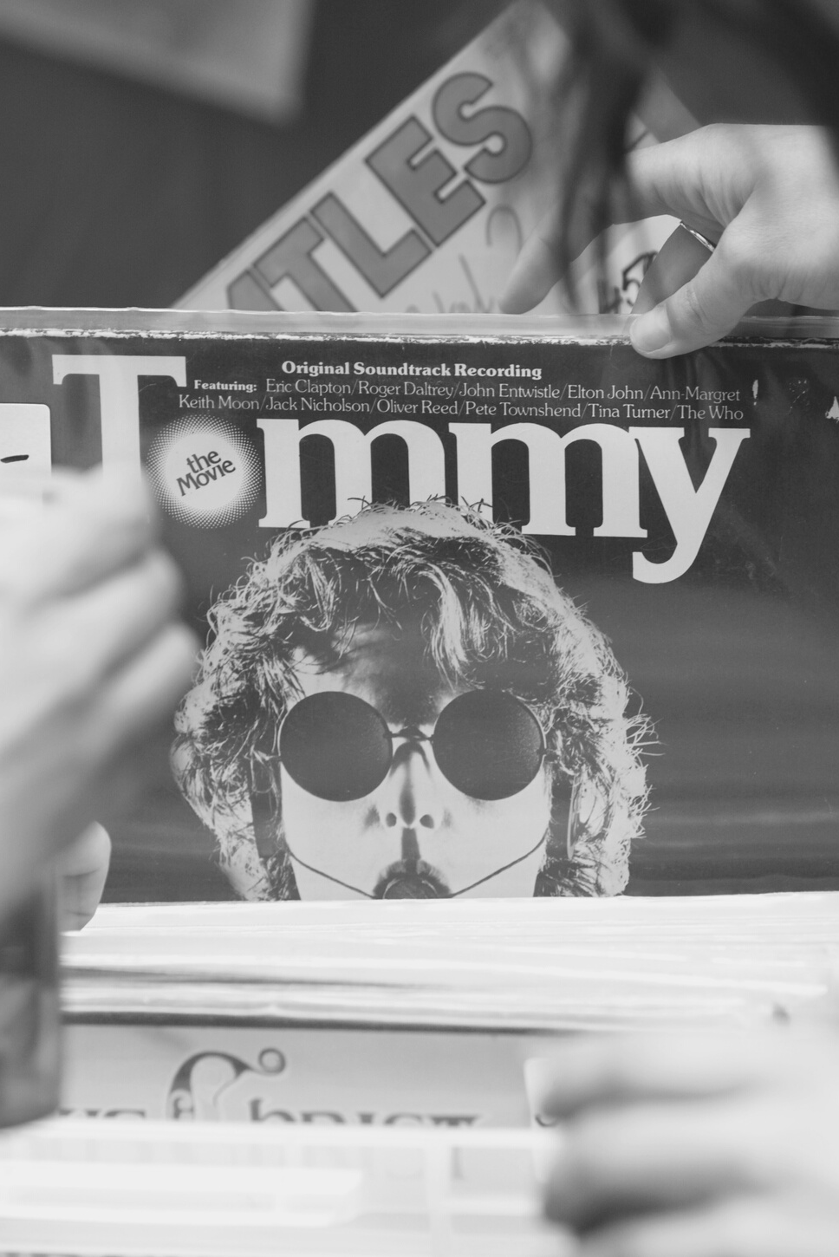
Our Values
Quality and value for money
Presentations are communication tools that can be used.
Innovation
Presentations are communication tools that can be used.
Excellent customer service
Presentations are communication tools that can be used.
Back
05/26
Next

Slide 33
Daring
Spirited
Imaginative
Up-to-date
Presentations are communication tools that can be used as demonstrations, lectures, speeches, reports, and more.
Presentations are communication tools that can be used as demonstrations, lectures, speeches, reports, and more.
Presentations are communication tools that can be used as demonstrations, lectures, speeches, reports, and more.
Presentations are communication tools that can be used as demonstrations, lectures, speeches, reports, and more.
01
02
03
04
OUR PERSONALITY
Back
06/26
Next

Slide 34

The Audios Co.
The Audios Co.
Visual Identity
A comprehensive visual language
Back
07/26
Next

Slide 35
Iconography
Guide to correct icon usage
Sizes
Padding
Lighting
Perspective
Back
01/25
Next

Slide 36

The Audios Co.
The Audios Co. Logo
The Audios Co.
Our logo and the meaning behind it
Back
09/26
Next

Slide 37
The Audios Co.
2015
Presentations are communication tools that can be used.
Branding milestones
2016
Presentations are communication tools that can be used.
2017
Presentations are communication tools that can be used.
Timeline of significant events
2018
Presentations are communication tools that can be used.
Back
10/26
Next

Slide 38


Our Logo Then
Presentations are communication tools that can be used as demonstrations, lectures, speeches, reports, and more. It is mostly presented before an audience.
The Audios Co.
Our Logo Now
Presentations are communication tools that can be used as demonstrations, lectures, speeches, reports, and more. It is mostly presented before an audience.
The Audios Co.
Back
11/26
Next

Slide 39
Logo Usage
Presentations are communication tools that can be used as demonstrations, lectures, speeches, reports, and more. It is mostly presented before an audience. It serves a variety of purposes, making presentations powerful tools for convincing and teaching.
The Audios Co.
Primary Logotype
Back
12/26
Next

Slide 40
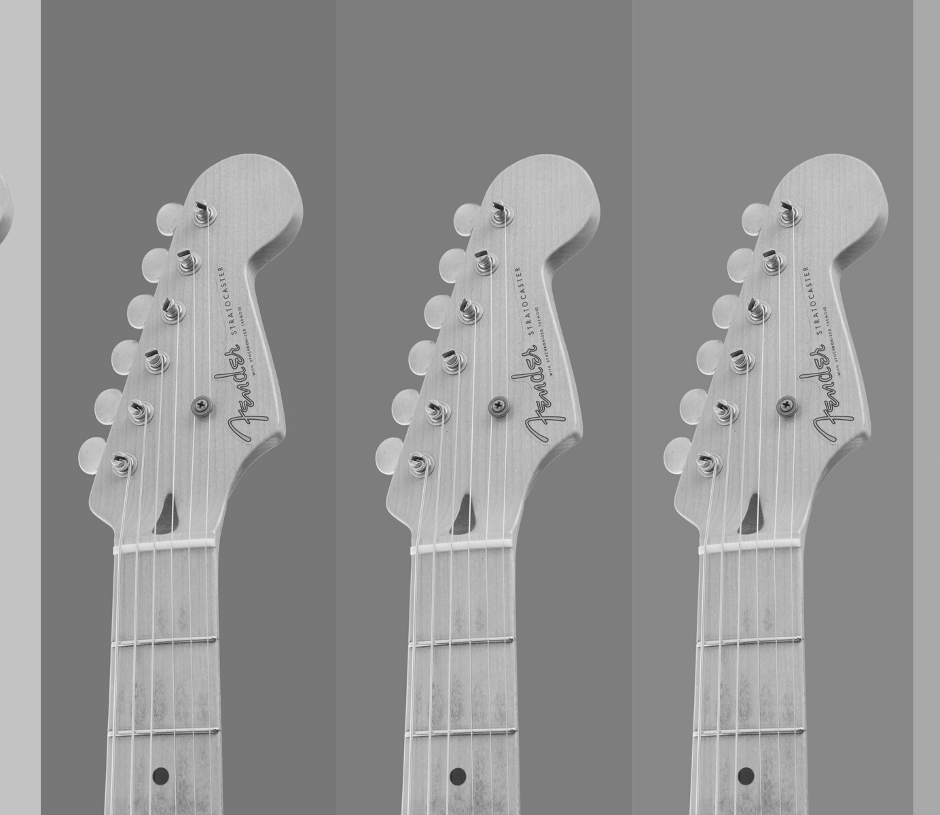
Color Guidance
How to use our brand colors
Presentations are communication tools that can be used as demonstrations, lectures, speeches, reports, and more. Most of the time, they’re presented before an audience. It serves a variety of purposes, making them powerful tools for convincing and teaching.
Back
01/25
Next

Slide 41
The Audios Co.
The Audios Co.
The Audios Co.
The Audios Co.
Primary Palette
Secondary Palette
Colors in Use
#d5d8db
#1d2b42
#d5d8db
Presentations are communication tools that can be used as demonstrations, lectures, speeches, reports, and more.
Presentations are communication tools that can be used as demonstrations, lectures, speeches, reports, and more.
Presentations are communication tools that can be used as demonstrations, lectures, speeches, reports, and more.
Back
15/26
Next

Slide 42
The band's
vision
Color
selection
The Audios Co.
Presentations are communication tools that can be used as demonstrations, lectures, speeches, reports, and more
Presentations are communication tools that can be used as demonstrations, lectures, speeches, reports, and mre
ALBUM ARTWORK GUIDELINES
Imagery
and style
Album
details
Presentations are communication tools that can be used as demonstrations, lectures, speeches, reports, and more
Presentations are communication tools that can be used as demonstrations, lectures, speeches, reports, and mre
Back
16/26
Next

Slide 43
The Audios Co.
Typography
Type family
Aa
Aa
Bb
Cc
Dd
Ee
Ff
Gg
Hh
Ii
Jj
Kk
Ll
Mm
Nn
Oo
Pp
Qq
Rr
Ss
Tt
Uu
Vv
Ww
Xx
Yy
Zz
00
01
02
03
Inter bold
04
05
06
07
08
09
Back
17/27
Next

Slide 44
The Audios Co.
Things to keep in mind
Typography Guidelines
Back
18/26
Next

Slide 45
The Audios Co.
Font Size
Tracking
Leading
Presentations are communication tools that can be used as demonstrations, lectures, speeches, reports, and more.
Presentations are communication tools that can be used as demonstrations, lectures, speeches, reports, and more.
Presentations are communication tools that can be used as demonstrations, lectures, speeches, reports, and more.
Back
19/26
Next

Slide 46
The Audios Co.
Font Size
Tracking
Leading
Presentations are communication tools that can be used as demonstrations, lectures, speeches, reports, and more.
Presentations are communication tools that can be used as demonstrations, lectures, speeches, reports, and more.
Presentations are communication tools that can be used as demonstrations, lectures, speeches, reports, and more.
Back
19/26
Next

Slide 47



Typography Applications
The Audios Co.
Web copy and album copy samples
Presentations are communication tools that can be used as demonstrations, lectures, speeches, reports, and more. It is mostly presented before an audience. It serves a variety of purposes, making presentations powerful tools for convincing and teaching.
The Audios Co.
Back
20/26
Next

Slide 48
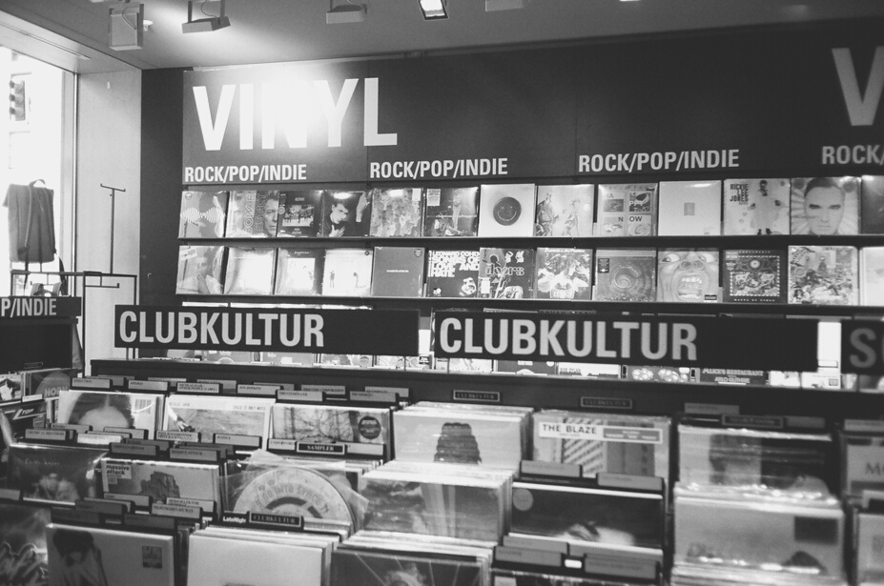
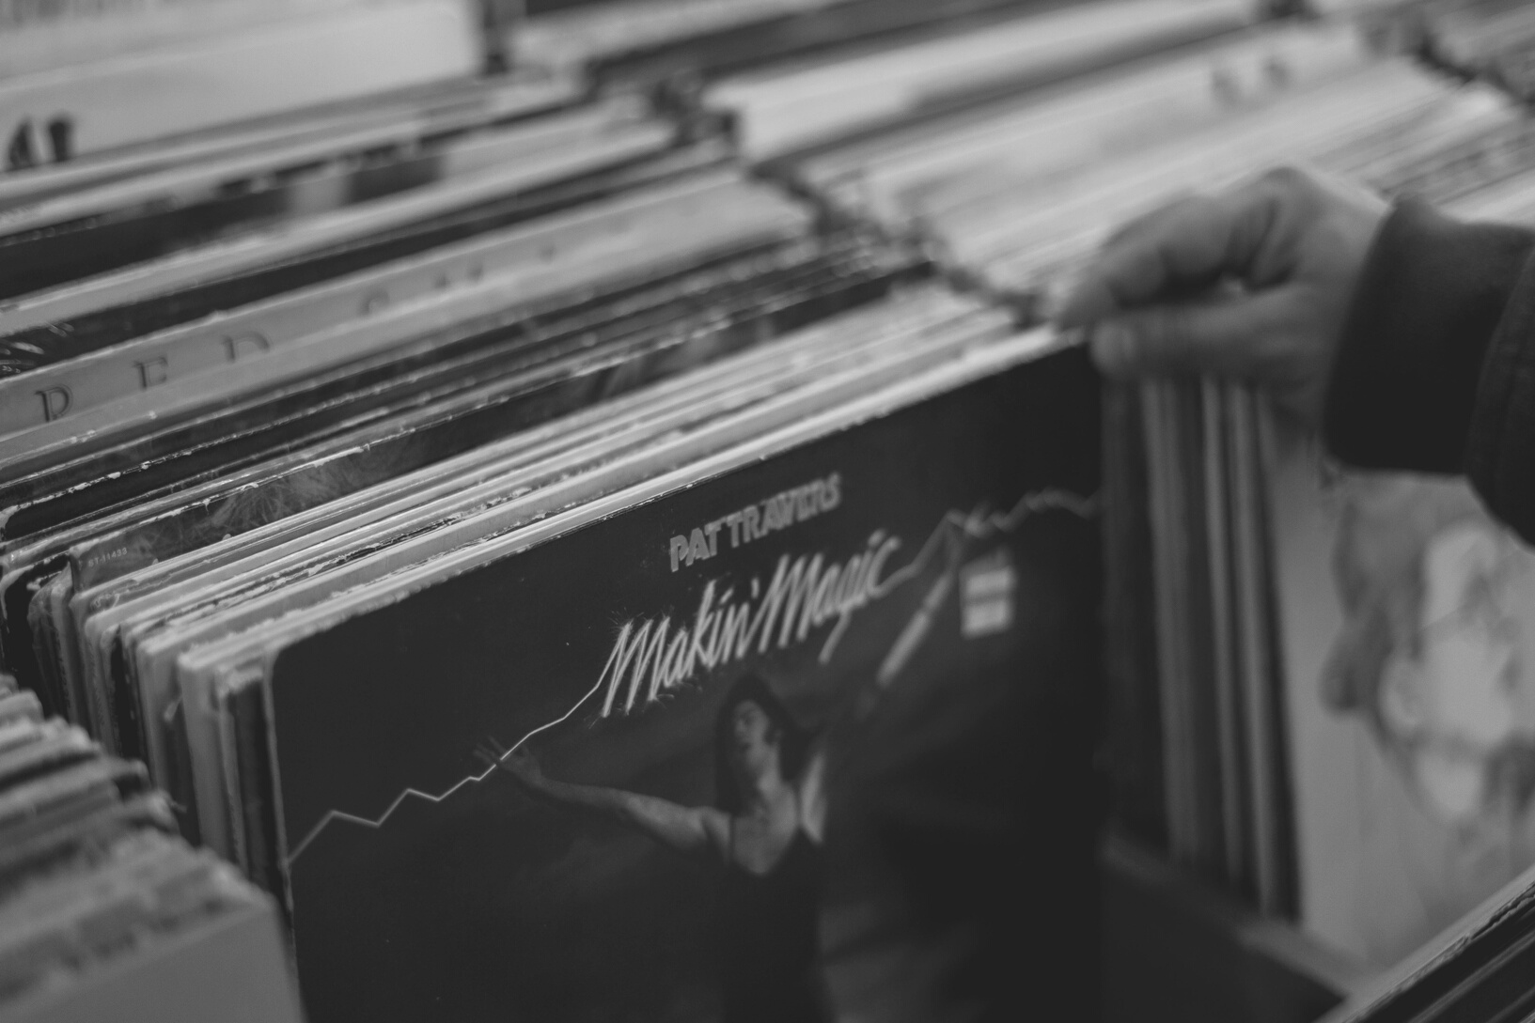
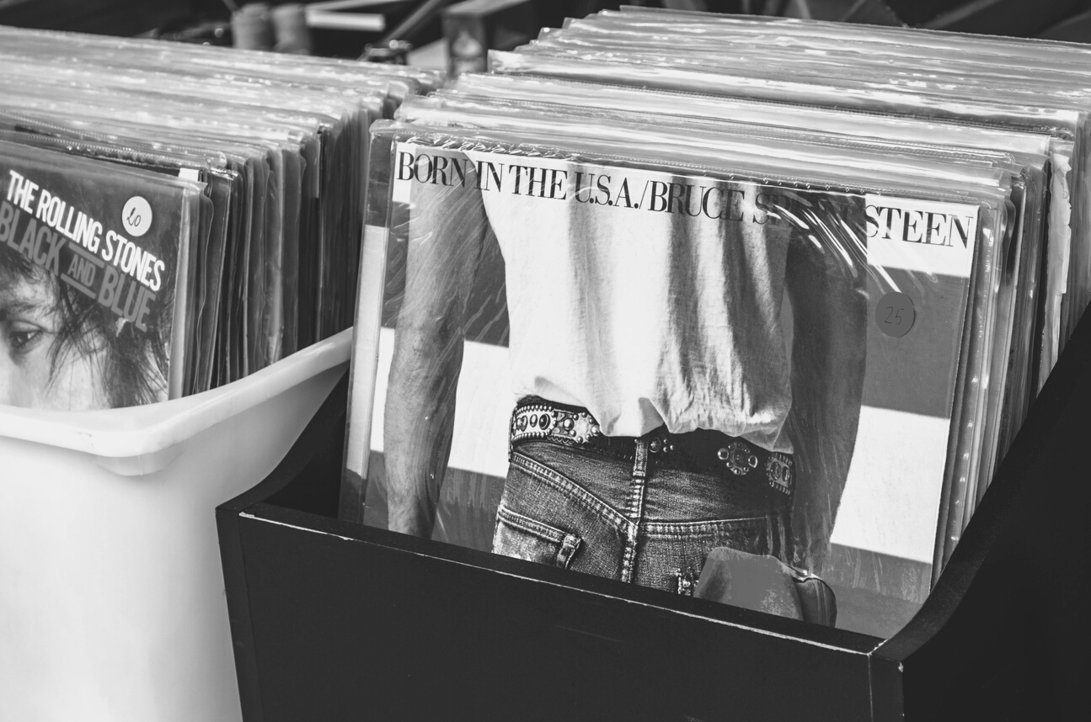
The Audios Co.
Photography
Presentations are communication tools that can be used as demonstrations, lectures, speeches, reports, and more.
Back
01/25
Next

Slide 49



GUIDE TO USING IMAGES
Presentations are communication tools
that can be used as demonstrations.
Presentations are communication tools
that can be used as demonstrations.
Presentations are communication tools
that can be used as demonstrations.
background
white space
Use of overlays
Back
22/26
Next

Slide 50
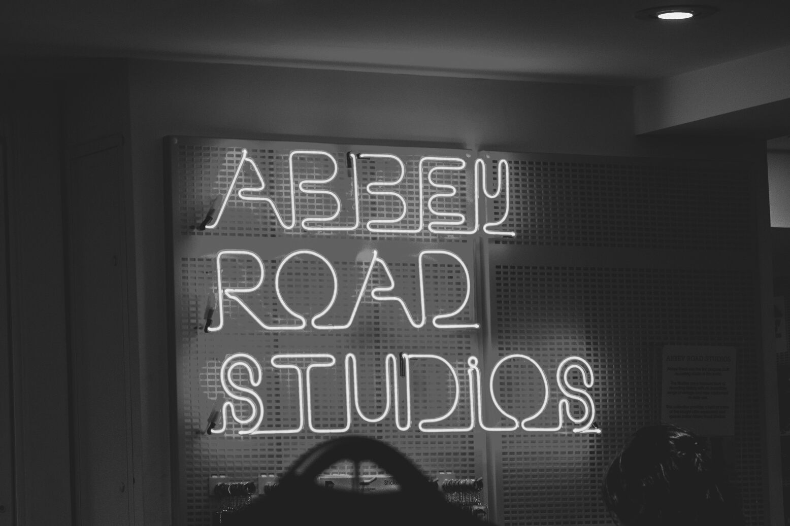
The Audios Co.
Presentations are communication tools that can be used as demonstrations, lectures, speeches, reports, and more.
Most of the time, they’re presented before an audience. It serves a variety of purposes, making them powerful tools for convincing and teaching.
Back
23/26
Next

Slide 51



The Audios Co.
GUIDE TO USING IMAGES
Facebook
Twitter
Pinterest
Presentations are communication tools that can be used as demonstrations.
Presentations are communication tools that can be used as demonstrations.
Presentations are communication tools that can be used as demonstrations.
Back
24/26
Next

Slide 52



The Audios Co. Brand Team
Sandra Mullins
Leonor Madrigal
Camden Michaels
Manager, Brand Equity and Identity
Head of Creative and Design Input
Brand Communications Associate
Back
25/26
Next

Slide 53
The Audios Co.
Keep
in touch
123 Anywhere St., Any City, State, Country 12345
Mailing Address
Email Address
hello@reallygreatsite.com
The Audios Co. Team
Phone Number
(123) 456 7890
Back
26/26

